Slide 1
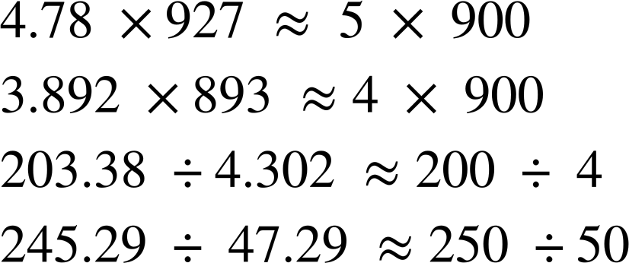

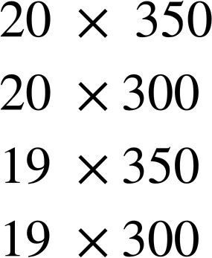
Estimating numerical calculations
Task A: Estimating using significant figures
1) Fill in the gaps to make the approximations correct. You can only use each number once.
a)
b)
c)
d)
2) To estimate this,
a) Which of these calculations would you use? Explain your choice.
There is no ‘right’ answer to this question. As long as there is justification to the calculation chosen.
For example, 20 × 350 is acceptable as 19.173 has been rounded to 1 s.f. and 338 has been rounded to the nearest 50.
20 × 300 is acceptable as 19.173 has been rounded to 1 s.f. and 338 has been rounded to 1 s.f.
19 × 350 is acceptable as 19.173 has been rounded to 2 s.f. and 338 has been rounded to the nearest 50.
19 × 300 is acceptable as 19.173 has been rounded to 2 s.f. and 338 has been rounded to 1 s.f.
b) Which of these gives the closest estimate?
c) Which gives the estimate that is furthest away?
19 x 350 gives the closest estimate, since 19.173 is closer to 19 than 20 and 338 is closer to 350 than 300.
20 x 300 gives the estimate that is furthest away, since 20 is further from 19.173 than 19 and 300 is further from 338 than 350.

Slide 2
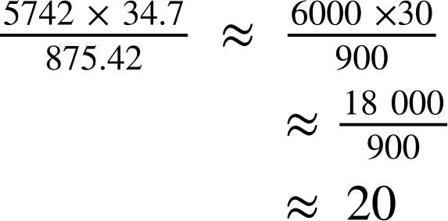
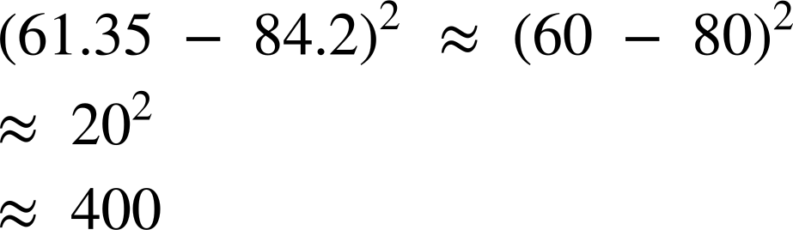
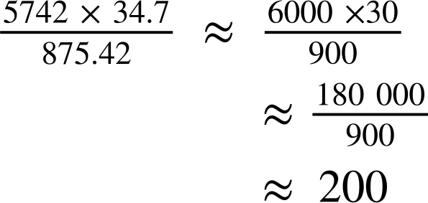

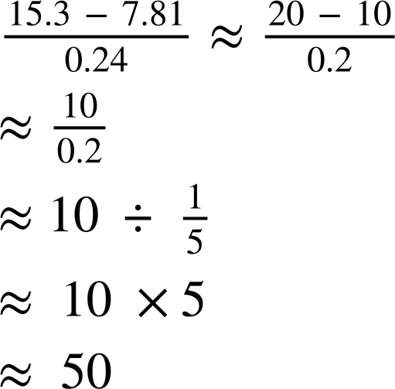

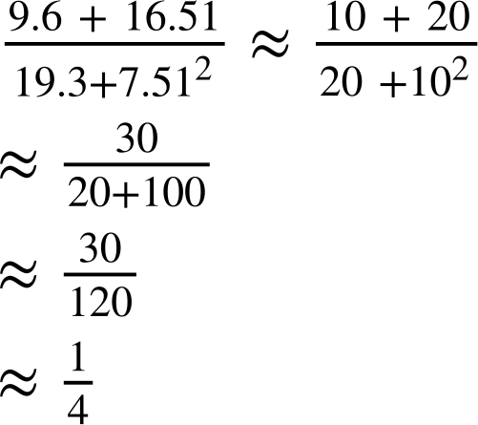
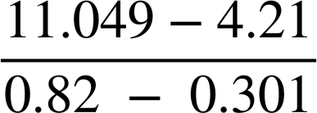
Estimating numerical calculations
3) Estimate the following, making sure to show your working out.
e.g.
a)
b)
c)
d)
e)
f)
‹#›

Slide 3
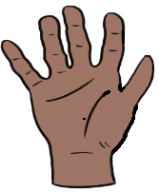
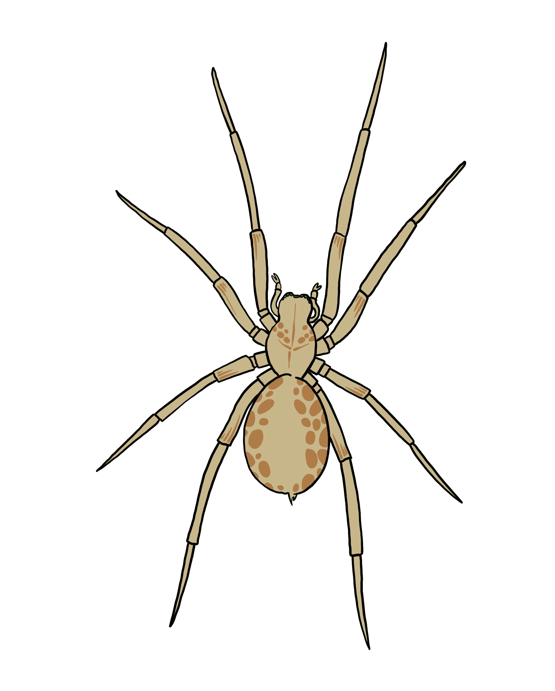
Estimating numerical calculations
Task B: Estimation in context
A science textbook uses comparisons with humans to show the sizes of different animals.
Which of these is a good estimate for the width of the hand?
10 cm 25 cm 5 cm
Use your answer to part a to estimate the size of the animals below.
b)
🐀
The rodent is approximately 1.5 times the width of a hand
c)
The spider is approximately a third of the width of a hand
Length
15 cm
Length
3 cm
2) a) What would be a sensible unit of mass to measure each of the items in the table?
b) Each of the values below matches one of the six items. Which is which?
baby 3.2 kg | elephant 4000 kg | Full suitcase 19 kg
Cargo ship container 2797 kg | newborn puppy 120 g | Packet of crisps 28 g
4000 | 3.2 | 120 | 28 | 19 | 2797
c) An orange weighs approximately 120 g. How many oranges do you think would be the equivalent of one of each of the things in part a?
Baby: approximately 25 oranges
Elephant: approximately 32 000 oranges.
Full suitcase: approximately 160 oranges
Cargo ship container: approximately 24 000 oranges
Newborn puppy: approximately 1 orange
Packet of crisps: approximately ¼ orange
‹#›

Slide 4
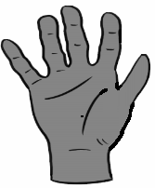
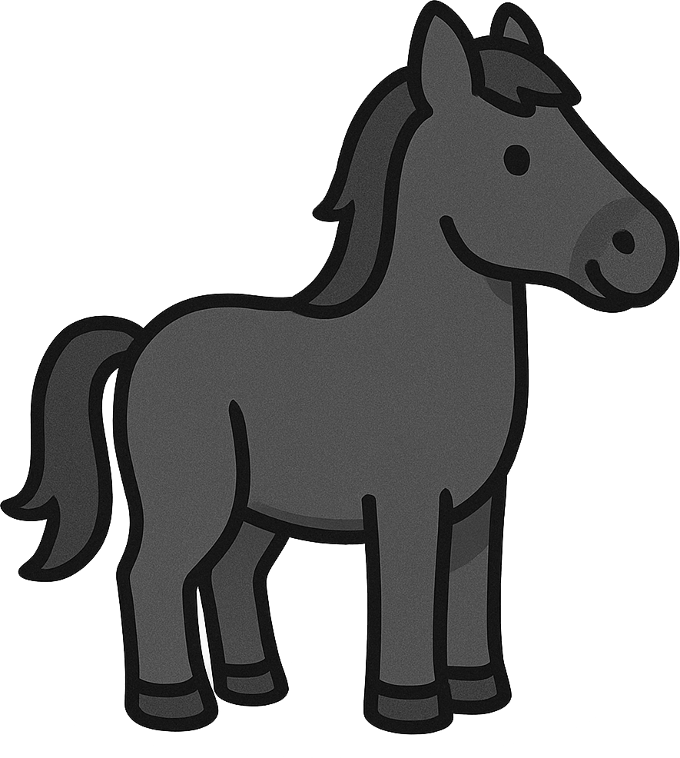
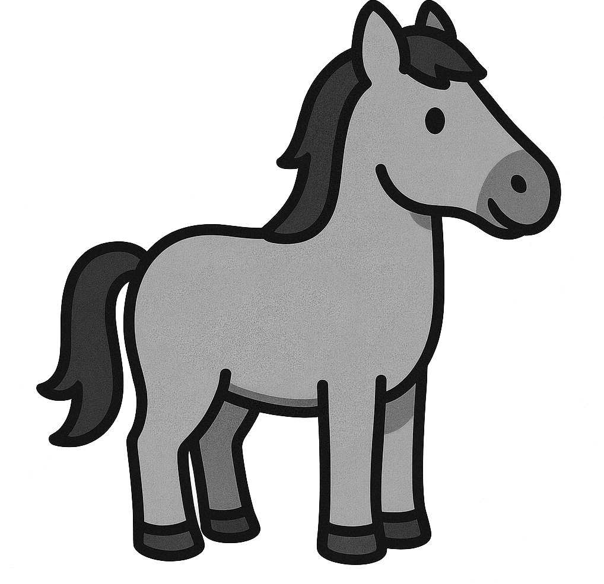
Estimating numerical calculations
3) Horses are measured using ‘hands’ as a unit, as shown below.
a) Estimate the height in centimetres of each of the horses.
From left to right: 9 hands and 17 hands. Answers will vary depending on the estimate for the width of a hand: 9 × their estimate, 17 × their estimate. So, for example, if hand is estimated as 10 cm the answers will be 90 cm and 170 cm.
b) The standard metric equivalent for a hand is 10.2 cm. Does this mean your estimate will be too big, too small or just right?
c) How many hands high are you to the top of your head?
Answers will vary.
d) Estimate some other objects using hands as a unit.
Answers will vary.
If you used an estimate length of a hand to be less than 10.2 then your estimate will be too small, if you used a length greater than 10.2 cm then your estimate will be too big.
Mathematics in Education and Industry
v2.3

